Slide 1
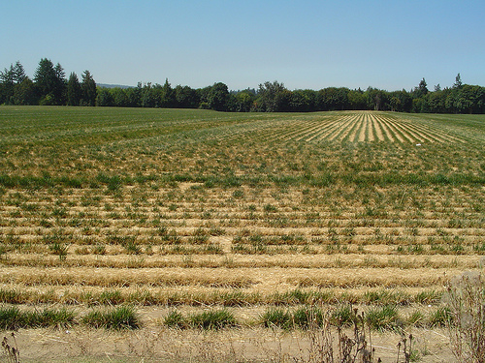
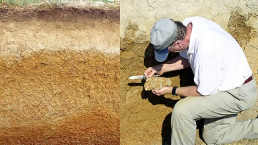
Unit One
Introduction to Soil Types, Structure and Pasture Management

Slide 2
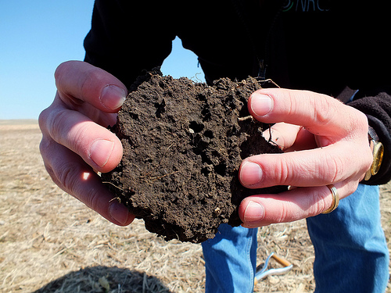
What is Soil?
The largest percentage of soil consists of weathered inorganic rock material. The amounts of different sizes and types of rock particles or grains determines the soil's texture. The three main types of rock grains found in soil are sand, silt, and clay.
A hectare of pasture land in a humid mid-latitude climate can contain more than a million earthworms and several million insects, which are vital because of their ability to mix and aerate soil. Increasing air and water availability to plant roots which greatly improves plant productivity.
Earthworms and insects also produce most of the humus found in a soil through the incomplete digestion of organic matter.

Slide 3
Types of Soil
Soils are named according to where their sand, silt, and clay composition plots on a soil structure triangle. Three of those are loam, topsoil and humus.
Loam: A kind of soil; an earthy mixture of clay and sand, with organic matter to which its fertility is attributed. A typical loam soil is made up of about a 20:40:40 mixture of clay, silt, and sand. Loam is considered ideal for gardening and agricultural uses because it retains nutrients and water well while still allowing the water to flow freely.
Loam is found in a majority of successful farms in regions known for their fertile land. Loam soils generally contain more nutrients and humus than sandy soils, have better infiltration and drainage than silty soils, and are easier to till than clay soils.

Slide 4
Types of Soil
Topsoil: :The most fertile soil, easiest to start new plants in. Topsoil is formed when mineral particles release due to weathering mixes, living soil organisms, and humus.
Topsoil in combination with other distinct soil layers are soil horizons, which can range in depth from millimeters to meters. Topsoil is the most important soil layer for plant growth. Loam is the most fertile of the topsoil, consisting of almost equal amounts of sand, silt, and clay.
Fertile topsoil has pores filled with half water and half air, thus maintaining an efficient balance between aeration, drainage, and water storage.

Slide 5
Types of Soil
Humus: Is the dark brown or black biochemical substance that gives color to the upper layers of the soil. Humus is difficult to see in isolation, because it binds with larger mineral and organic particles. Humus provides soil with a number of very important benefits:
It enhances a soil's ability to hold and store moisture.
It reduces the eluviation of soluble nutrients from the soil profile.
It is the primary source of carbon and nitrogen required for plant nutrition.
It improves soil structure.

Slide 6
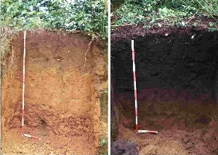
Comparison between humus-rich and humus-poor soil
The soil on the left is a highly weathered and without strong humus formation.
The soil profile on the right, with its rich, dark brown color, demonstrates good humification.

Slide 7
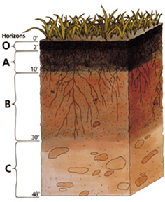
Soil Structures
Soil has different layers called horizons. The picture at the right shows a general example of the layers, their appearance and their depth in inches.
fig. 1 from Boundless.com A generic soil profile

Slide 8
Soil Structure: O Horizon
The O horizon is the top layer at the soil surface. It consists of surface litter, such as fallen leaves, sticks and other plant material, animal waste, and dead organisms. A distinct O horizon may not exist in all soil environments (e.g., desert soil).
fig. 1 from Boundless.com A generic soil profile

Slide 9
Soil Structure: A and B Horizon
Below the O horizon is the A horizon This layer contains organic humus, which usually gives it a distinctive dark color.
The B horizon or sub-soil is the next layer down from the surface. It consists mostly of inorganic rock materials, such as sand, silt, and clay.
fig. 1 from Boundless.com A generic soil profile

Slide 10
Soil Structure: C Horizon
The C horizon sits atop bedrock and, therefore, is made up of weathered rock fragments. The bedrock is the source of the parent inorganic materials found in the soil.
fig. 1 from Boundless.com A generic soil profile

Slide 11
Soil Mismanagement: Patterns that damage soil quality
Livestock traffic on wet soil- too much livestock traveling on wet soil causes too much soil compaction and damage to soil structure.
Over grazing- Allowing animals to over graze ground creates weak forage growth and sustainability.
Soil acidification - acidification results from the removal of soil during crop harvest, the use of acid-forming nitrogenous fertilizers and/or acid rain.
Soil contamination- results from the addition of pollutants from various sources.

Slide 12
Soil Mismanagement: Patterns that damage soil quality
Soil salination- or the excess accumulation of free salts, which can lead to reduced plant growth, erosion due to loss of plant cover and soil structure, and water quality problems due to sedimentation. Soil salination is particularly problematic in arid lands and often results from irrigation.
Erosion – one of the most serious soil mismanagement problem is soil erosion. Erosion is a natural process, but in many places, it is greatly increased by human land use, especially poor land use practices, such as deforestation, overgrazing, and improper construction activity.

Slide 13
Soil Management
Soil management includes operations, practices, and treatments used to protect soil and enhance its performance.
Examples of soil management practices include:
1. controlling traffic on the soil surface to help reduce soil compaction (which in turn reduces aeration in soil and water infiltration)
2. using cover crops to keep the soil anchored and protected in off seasons, so that the soil is less eroded by wind and rain

Slide 14
Soil Management
3. rotating crops to increase the amount of plant residue left on the soil surface (which also protects the soil from erosion).
4. nutrient management helps improve soil fertility and increase organic matter content, which improves soil structure and function.
5. Using Reduced- or no-tillage options when planting forage mixes or crops limit the amount of soil disturbance and help maintain plant residues on the surface, improving both erosion protection and water retention.

Slide 15
Soil Management
Soil management by fertilizer application and other agricultural practices has been instrumental in the establishment of modern society.
Throughout the history of mankind, mismanagement of soil has had adverse environmental effects. A notable example includes the American Dust Bowl.
Poor soil conditions as a result of chemical contamination, mineral deficiency, acidity, salinity, and improper drainage, leads to reduction of farmland productivity.
Sustainable agriculture (the practice of farming using principles of ecology, the study of relationships between organisms and their environment.) can be achieved by application of a variety of farming methods that are safe for environment, profitable, and conserve resources.

Slide 16
Soil Management
Sustainable options for replenishing nitrogen in the soil could include:
(1) recycling crop waste and treated or untreated animal manure
(2) growing legume crops that form symbioses with nitrogen-fixing bacteria thus producing Nitrogen in the soil
(3) industrial production of nitrogen
(4) genetically engineering non legume crops to (like regular legume crops that contribute important Nitrogen into the soil)

Slide 17
Testing Your Soil: Timing
Generally, you will want to take your soil sample after crops (if planted) have been harvested in the fall so you can prepare your field or pasture for forage planting in the spring.
You also want to properly schedule soil tests in conjunction with fertilizers that have special times they need to be used. However, you can sample soil at any time of the year.
As a general practice you should sample your soil every 3-5 years.

Slide 18
Testing Your Soil: Timing
If you know that certain phosphorous fertilizers, lime or manure has been applied to the soil it is best to wait 3 months after that application to test the soil otherwise results could be inaccurate.
Remember being ready with your intentions and plan for your pasture(s) is important. You don’t want to mismanage your time in planning out an appropriate schedule for pasture maintenance this may cause unprofitable pastures for you in the future.

Slide 19
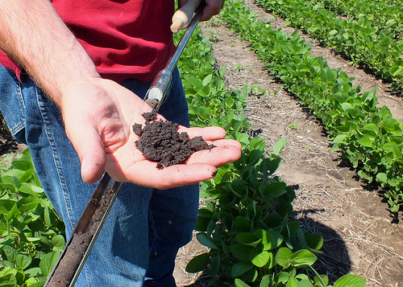
Testing Your Soil: Taking a Soil Sample
Tools: shovel or soil tube/soil auger, clean bucket, sample bag from your local extension center OR empty (clean) pound or half pound coffee can or ziplock bag
The size of your pasture will determine how many samples you need to take. Usually you want to divide pastures into 20 acre (or less) sections.

Slide 20
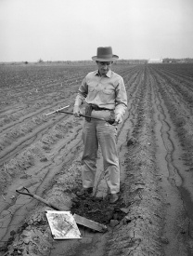
Testing Your Soil: Taking a Soil Sample
Example: If you had a 20 acre pasture you would take 4-5 samples going one direction and then 4-5 again the other direction. In a crisscross pattern. Soil sample depth should be around 6 inches deep. Put the samples of soil (taking the sample from the 6-7 inch soil core depth) into a bucket throwing out any plant debris. . You need to sample from many different areas to get the most accurate results, but avoid taking samples from livestock feeding areas or wooded areas. For this example the end result would be around 10-15 different samples.

Slide 21
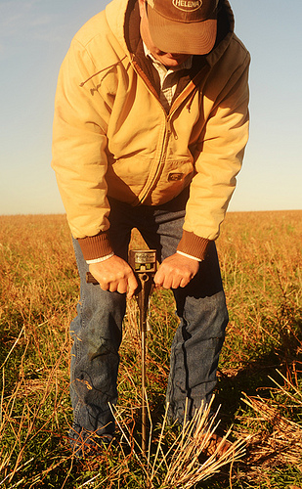
Testing Your Soil: Taking a Soil Sample
Next, mix the samples in your bucket thoroughly and then take 8 -16 ounce (pound) sample placed in the coffee can or ziplock bag to extension center. They will send in different container.
Once the sample has been taken to your local agriculture extension center and they have sent it to the lab you will then get the results back in 1-3 weeks depending on how busy your lab is.

Slide 22
University Extension Centers/Regional Extension Centers
Your state university extension center(s) and regional (local) extension centers are there to help you in all stages of your small farm/agriculture journey. They not only assist with soil testing and sampling, but also provide information and assistance regarding seeding formulas, dry yield formulas, figuring stocking rates and more.
Therefore, it is important for you to get to know your areas extension center and how it operates. They are a valuable resource for anyone in the business of agriculture.
Here are some university extension centers located in the Midwest United States:
1. University of Missouri Extension Center: http://extension.missouri.edu/
2. Iowa State University Extension: http://www.extension.iastate.edu/
3. University of Minnesota Extension: http://www1.extension.umn.edu/

Slide 23
University Extension Centers/Regional Extension Centers
4. Illinois University Extension: http://web.extension.illinois.edu/state/index.html
5. Kansas State University Research and Extension: http://www.ksre.ksu.edu/p.aspx
6. University of Nebraska Extension: http://www.ksre.ksu.edu/p.aspx
7. North Dakota State University Extension: http://www.ag.ndsu.edu/extension/
8. South Dakota State University Extension: http://www.sdstate.edu/sdsuextension/index.cfm
Depending on your location you may have a closer regional center located nearer to where you live. If you live in a county that practices a lot of agriculture then you will have a close local extension service or branch that works with the university extension to obtain information for you. Many times these local extensions are located at city court houses.

Slide 24
Using Your Results
Once you get your soil test results back from your extension center the next step is to take the test results to a fertilizer plant and they will create a fertilizer mix for you based off the results of your soil test.
The fertilizer plant will then put your calculated mix on a spreader and spread it on your fields or pastures (you pay per acre and cost of fertilizer) or if they are busy you have the option of applying the fertilizer yourself by renting an applicator cart.

Slide 25
What is Pasture Management?
Pasture management includes:
Maintaining pasture soil quality
Keeping pasture free of weeds, un wanted trees and shrubs
Adopting a grazing plan
Selecting the right forage species for your operation

Slide 26
Pasture Management: Things to Consider
1. Overgrazing and Under grazing: If a pasture is over grazed this can lead to problems such as poor forage growth rates, weak forage species and even increased run-off and poor soil due to an increased temperature. If a pasture is under grazed it can lead to the accumulation of unwanted plant species and in turn an unprofitable pasture.
2. Applying fertilizers: Your soil test results will help you know if you need to apply fertilizer and which fertilizers to apply for pasture maintenance.
3. When to use Lime: Your soil test results will tell you if you need to apply lime to your pasture. Lime helps correct soil acidity.

Slide 27
Pasture Management: Things to Consider
4. Controlling weeds and shrubs: If you are having a problem with specific unwanted plants you can help correct the problem by changing your grazing plan and or using lime and fertilizers appropriately. Clipping and mowing are also options to control weeds and shrubs livestock will not eat.
5. Water: Water location and water quality are high priorities in pasture management. It is best practice to have your water supply within 600 feet of your livestock’s grazing area. This is because you don’t want your livestock to waste excessive time and energy traveling to water sources.

Slide 28
Pasture Management: Things to Consider
6. Selecting forage species: There are many factors when choosing appropriate forage species. We will be discussing these in the weeks to come. Traits of different forage species must be matched with intended livestock, soil, lime and fertilizer usage.
7. Encourage Legumes: Legumes are plants that help introduce Nitrogen in the soil. They include plants such as alfalfa, clovers and beans. Legumes make wonderful additions or mixes with other forage grasses. Additionally, many farmers use them as a rotating crop to help improve soil quality. We will take a more in depth look at legumes in our next unit.

Slide 29
Pasture Management
As you can see there are many factors involved with pasture management. Soil, which we have discussed this week and will continue to discuss next week, is just one factor.
In the weeks to come we will continue to discuss the importance of soil maintenance as well as all the other important aspects of pasture management. By the end of the course you will have the tools you need to build your own pasture management plan!

Slide 30
Content Credits
Boundless.com – Biology- Chapter 46 Plant Nutrition- (section 2) Soil Ecosystem – “Lignin to Humus”
Boundless.com – Biology – Chapter 46 Plant Nutrition- (section 2) Soil Ecosystem – “Role of Soil Conservation in Sustainable Agriculture”
Boundless.com – Biology – Chapter 46 Plant Nutrition- (section 2) Soil Ecosystem – “Texture of Soil”
Boundless.com – Biology – Chapter 46 Plant Nutrition- (section 2) Soil Ecosystem – “Organic Components of Soil”
Jim Donaldson, course developer

Slide 31
Image Credits (in order of appearance)
“Harvested Grass Seed field” by born1945 CC BY 2.0
http://www.flickr.com/photos/12567713@N00/227607861/
“Soil Scientist at Work (4)” BY Soil Science CC BY 2.0 http://www.flickr.com/photos/soilscience/5094929872/
“Managed Meadow (Annually mowed in spring) at Cherokee Park” by mightyjoepye CC BY 2.0 http://www.flickr.com/photos/mightyjoepye/3995160332/
“Soil Pores In Healthy Soil” by NRCS Soil Health CC BY 2.0 http://www.flickr.com/photos/87743206@N04/8053617246/Healthy Soil.jpeg
“Soil Centipede” by Matt Reinbold CC BY-SA 2.0
http://www.flickr.com/photos/furryscalyman/2092230152/ Soil Centipede.jpeg

Slide 32
Image Credits (in order of appearance)
“soil-profile” Boundless.com – Biology – Chapter 46 Plant Nutrition- (section 2) Soil Ecosystem – “Texture of Soil” http://commons.wikimedia.org/wiki/File:Soil_profile.png
“tera-pera” Boundless.com – Biology – Chapter 46 Plant Nutrition- (section 2) Soil Ecosystem – “Organic Components of Soil” http://commons.wikimedia.org/wiki/File:Terra_Preta.jpg
“Soybean Field with Healthy Soil” by USDA NRCS South Dakota CC BY-SA 2.0 http://www.flickr.com/photos/nrcs_south_dakota/9316804120/
“Soil Testing” by Texas A&M Cushing Memorial Library and Archives CC BY 2.0
http://www.flickr.com/photos/cushinglibrary/3657263606/
“Tommy Soil Pressure Test No Till2 LR” by U.S. Department of Agriculture (USDA) CC BY 2.0 http://www.flickr.com/photos/usdagov/8465155025/

